Slide 1
ALE2024
AgriFinALE2024

Slide 2
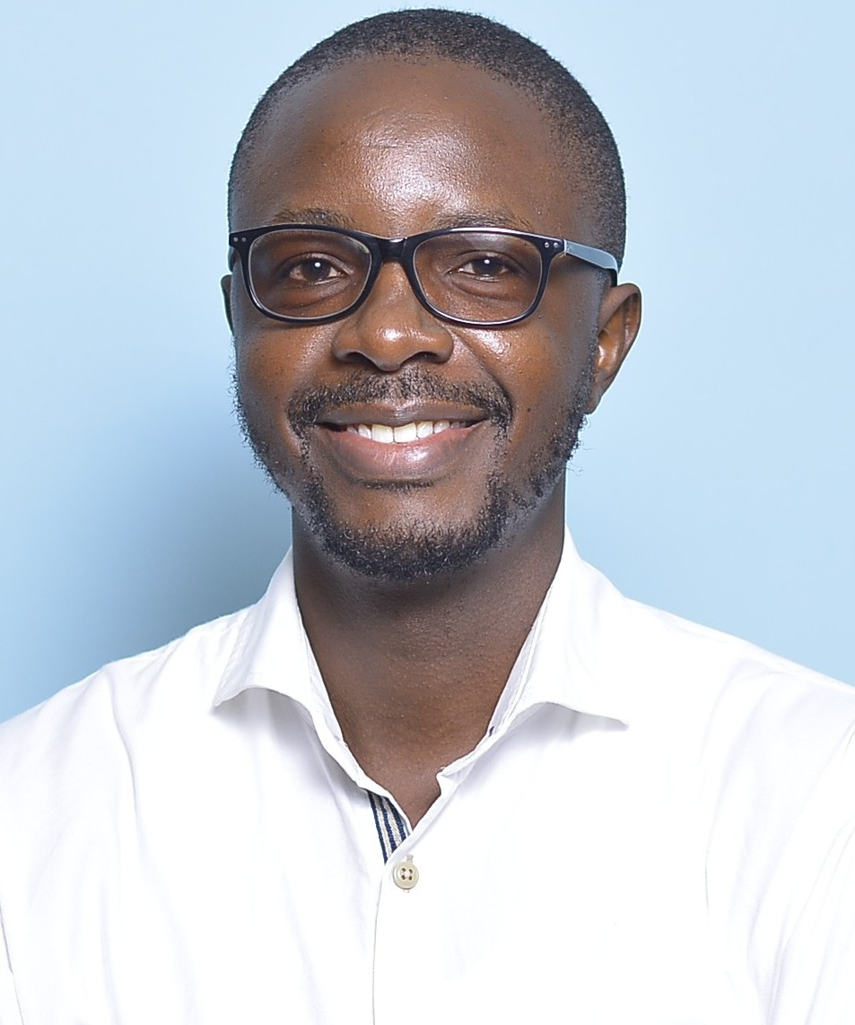
Scaling innovation
in rural economies through Agtechs and Fintechs
Jared Ochieng
Senior Agriculture Specialist

Slide 3
Setting the context
Optimistic visions of technology-led development, characteristic of broader narratives of Africa rising, have long animated investment in Kenya’s Silicon Savannah. Collectively, over USD 800 million raised.
What challenges do smallholders face?
Key problems for platforms interfacing with smallholders
3.
How have platforms invested to overcome these key problems?

Slide 4
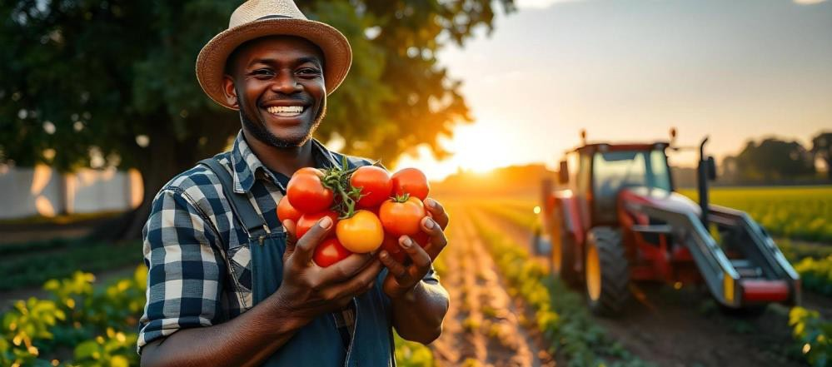
What challenges do smallholders face?
01
Input/output markets/Information
How can I access better inputs to increase productivity?
Who would be willing to buy? (options?)
How can I get the best prices?
Logistics
How will I get and store inputs for production?
What is the best way to get my product to market?
What do I need (storage, transport, price information) to sell at the optimal time and/or price?
Liquidity
How can I optimise making and receiving payments?
How can I finance?
How can I make investments to increase production? (short-term & long-term)

Slide 5
Key problems for platforms interfacing with smallholders
02
High transaction costs
Reaching, developing trust with, and onboarding
Aggregation is costly. Side - selling
Applicable financial models
Volatile incomes and low liquidity means that SHF are not an ‘easy’ market.
Diversity of practices, produce, and ecologies at smallholder level can challenge centralised and standardised platform processes.
(e.g. digital extension service advice face challenges to scale when dealing with such a variety of crops and climate and farming practices. Microclimates can mean that climate/soil sensors may be inaccurate at local levels. Satellite imagery without sufficient granularity may be insufficient for smallholder needs, etc.)

Slide 6
How have platforms invested to overcome these key problems?
03
Organizations have invested enormously to overcome these challenges including in:
IoT / remote sensing technologies
Improving AI / large language models
Digital finance / digital customer relationship management
Digital literacy / training for farmers
Paygo financing
Large field teams to reach farmers and develop trust
However, these attempts still makes the digital platform responsible for coordinating across farmers. Still,
Are expensive for platforms
Are inefficient in that each platform will have to perform similar outreach and coordination work
Risk centralisation and excess corporate power if few platforms ultimately come to dominate.

Slide 7
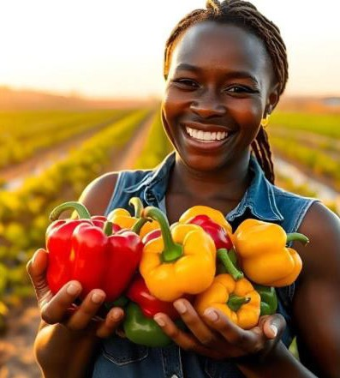
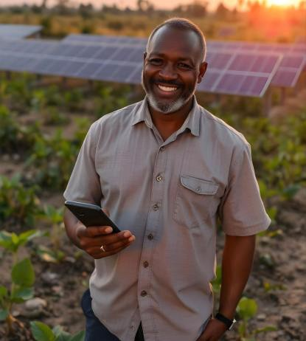
Is Kenya increasingly becoming a startup graveyard?
How many of the Agtechs/FinTechs below have either closed down, entered administration, or exited Kenya?
How many are facing cash shortages, have downsized, heavily restructured, or pursuing mergers?
Firm/ Platform | Total Raised (USD)
Twiga Foods | 195 million
Wasoko | 144 million
Gro Intelligence | 125 million
Copia Global | 120 million
Swvl | 100 million
MarketForce360 | 42.5 million
WeFarm | 32 million
Sendy | 26.5 million
iProcure | 17.2 million
Sources: CrunchBase, DisruptAfrica, TechCrunch, BusinessDaily, Semafor

Slide 8
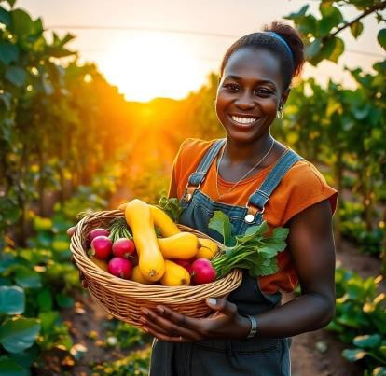
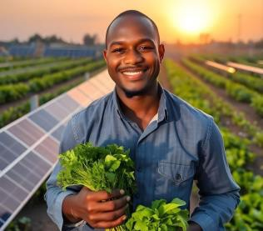
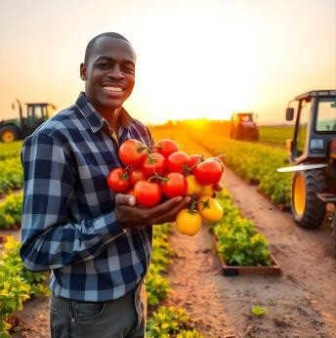
After such enormous injections of cash, how are they still struggling?
Strategic errors and inadequate management capacity?
Fragile tech startup financing ecosystem and pressures from investors to scale?
through a mix of angel investors, concessional finance, and impact investors, supplemented by grants
Subsequent funding rounds typically attract major venture capital (VC) investors who take equity in the firm (i.e. a share of ownership) in exchange for funding.

Slide 9
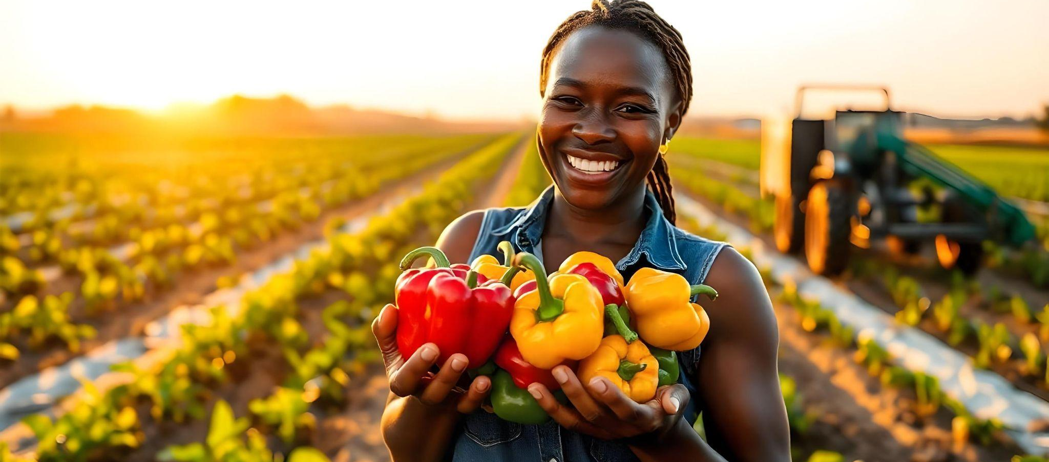
The problems with the rapid scale ‘scale up’ model:
Introduces fragility into the system. Makes start ups susceptible to shocks like a pandemic or inflation or FX risk, start ups are already too leveraged and can’t easily adapt or pivot; and capital will quickly pull out.
Pushes innovators into unsustainable business models to demonstrate rapid growth - for instance subsidised credit.
3. Mismatch between the needs of VCs and the needs of consumers- e.g. small-scale farmers. Business models are shaped for the former not the latter.
4. Crowding out: a mental model that ties together VC and innovation leaves little room for developing or imagining alternative funding models.

Slide 10
How can we address this?
We don’t have the answers, but these are areas we might want to explore:
Alternative funding models – i.e., leveraging local capital like pension funds on a patient capital model which incentivises slow and resilient growth.
Encouraging ventures to “scale deep” – Involves cultivating relationships with local funders, and, in so doing, growing sustainably. Continuing to support incubators who can work with innovators to broker partnerships and collaboration, reduce costs- e.g. through shared infrastructure- and build capacity.
Bringing in social intermediaries like SACCOs, Cooperatives and Farmer Associations to potentially be a source of funding, but they can also partner with innovators to develop and distribute solutions that work for their constituents.

Slide 11
How can we address this? Cont’d
Lastly, the role of public investment particularly in infrastructure cannot be understated. While the digital world is useful for coordination, ultimately the agricultural economy is deeply material. Investments in roads, rail, etc. are central. Even digital platforms can only offer so much to farmers if they cannot reach them or if they get stuck in the mud, etc.

Slide 12
Creating value through inclusive finance
ALE2024
AgriFinALE2024

