Slide 1
#ALE2024
#AgriFinALE2024

Slide 2
State of Agtech Investment in Africa 2024
Presentation by:
David Saunders
Director Briter Bridges and Programme Lead of AgBase
Your best Photo goes here!
Just drag and drop your photo here.

Slide 3
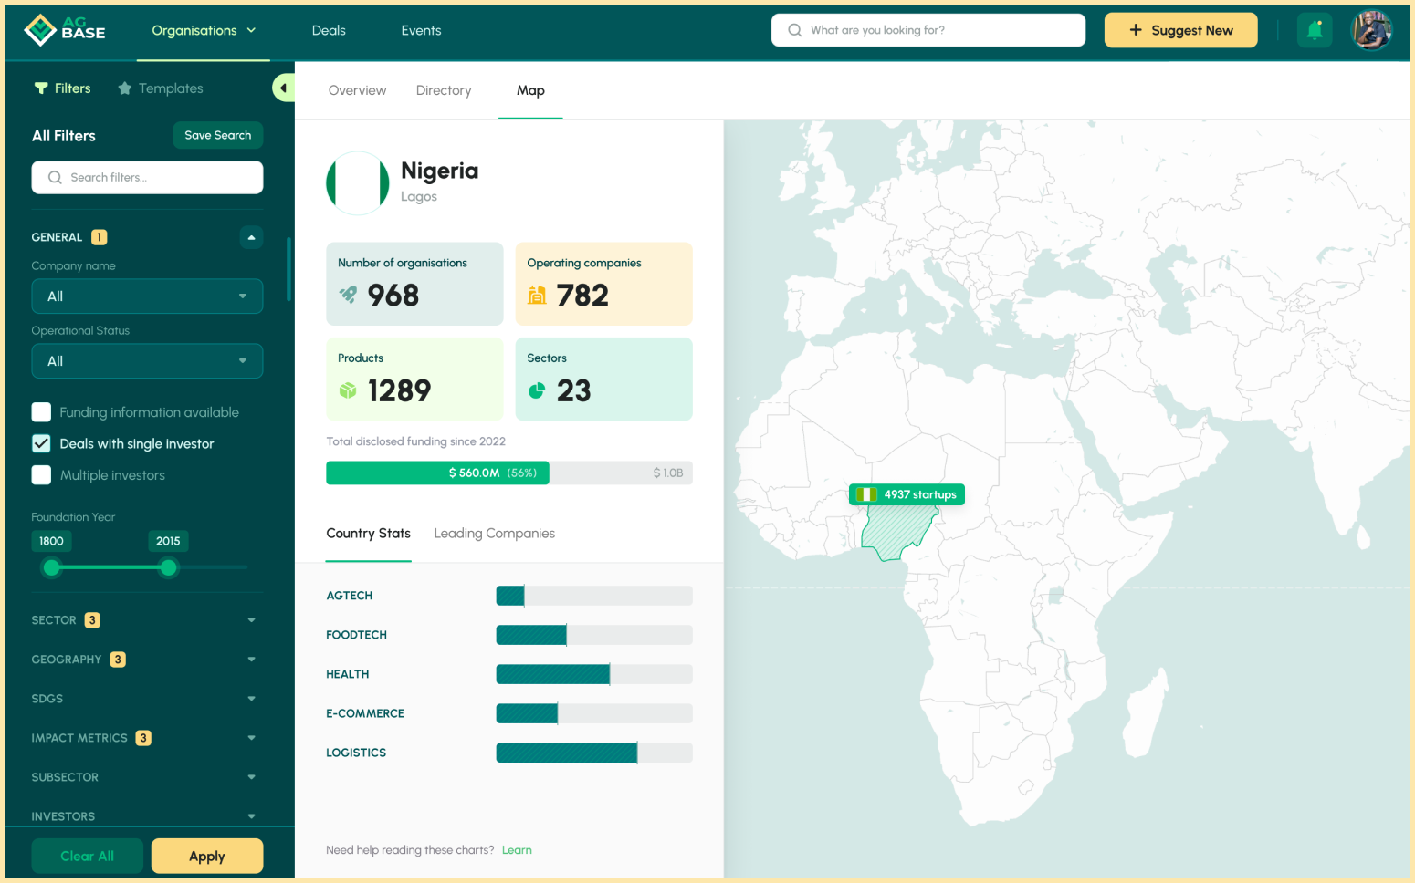
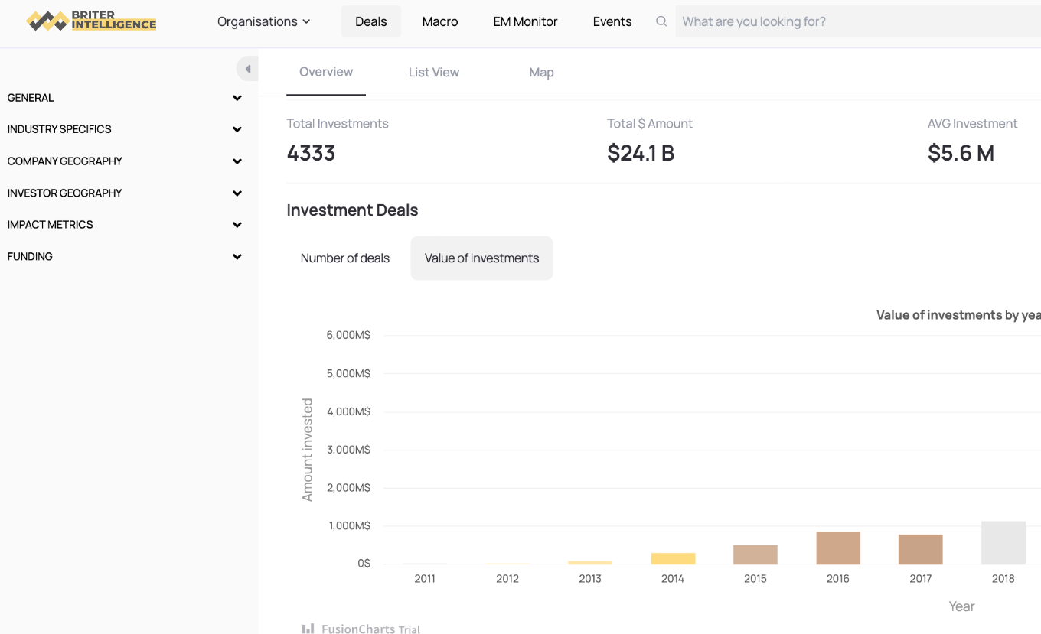
About AgBase:
A partnership for impact, powered by Briter Intelligence
State of AgTech Investment 2024
REPORT
AgBase is an initiative of Briter Bridges backed by the Bill and Melinda Gates Foundation and The Foreign, Commonwealth & Development Office (FCDO), and implemented in partnership with MercyCorps AgriFin.
It is a business intelligence platform powered by Briter Intelligence that connects investors, businesses, and innovators to data, research, and market insights to fuel AgTech and FoodTech ecosystems in the Global South.
$1.5bn worth of funding logged for AgTechs
600+ transactions from pre-seed to Exit
1000+ profiles on AgTechs, Funders and ESOs
https://agbase.briterbridges.com/

Slide 4
State of Investment in Agtech in Africa 2024
Establishing the new baseline for AgTech Investment in Africa

Slide 5
Establishing a new baseline:
AgTech funding has stabilised around a new baseline over the last 2 years
State of AgTech Investment 2024
REPORT
As of Q3 2024, there are at least 745 active AgTechs across the continent. More than half, or 426, have received funding since 2014 totaling more than $1.56 billion across 700+ investments.

Slide 6
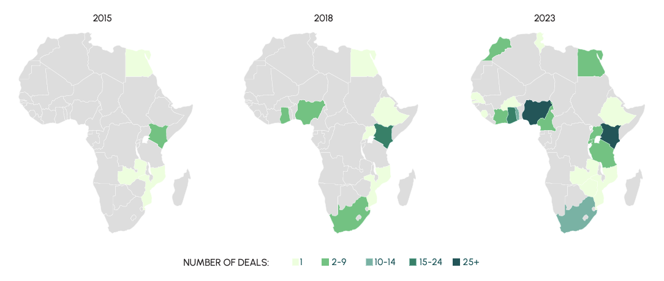
Establishing a new baseline:
A few countries have dominated, but new geographies are emerging
State of AgTech Investment 2024
REPORT
AgTech has largely been concentrated in the “Big 4”. However, other countries are showing. In Ethiopia, Zambia and Mozambique, AgTech represents more than 30% of the total funding in their overall startup ecosystems.

Slide 7
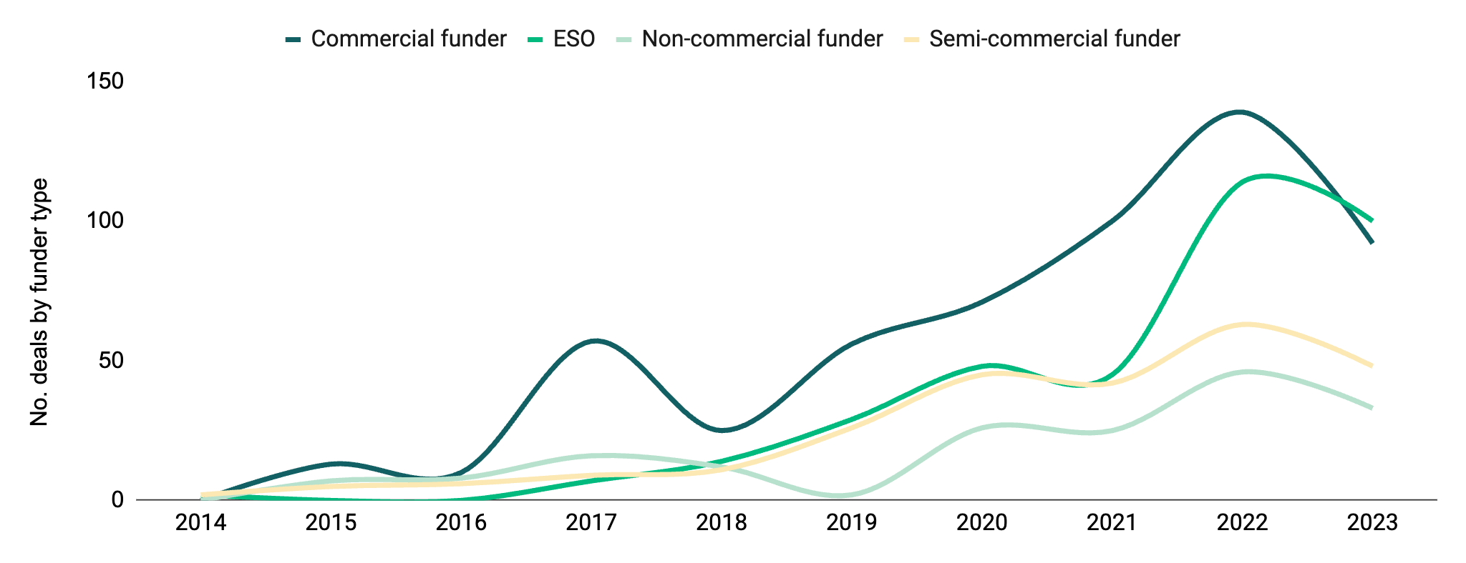
Establishing a new baseline
The composition of funders has changed over the last few years
State of AgTech Investment 2024
REPORT
From 2019 to 2022 commercial funders grew by more than 300% and accounted for nearly 50% of all deals in 2021. By 2023, commercial funders only accounted for a third of deals to AgTechs in Africa, with two-thirds of deals coming from ESOs, semi-commercial and non-commercial funders.
-12%
-34%
-28%
-24%

Slide 8
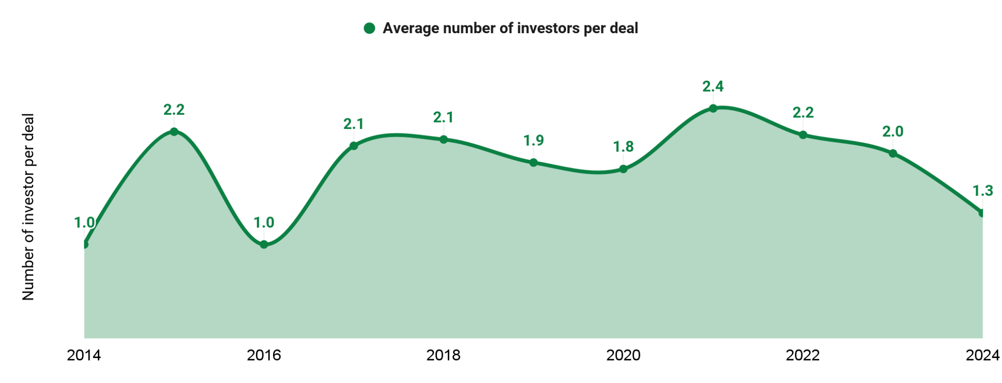
Establishing a new baseline
Collaboration between investors declining from 2021 peak
State of AgTech Investment 2024
REPORT
On average, there are two funders involved in each AgTech deal across all funding stages. However, this has been declining in recent years. In 2021 there was an average of just under 2.5 investors per deal, indicating a period of heightened collaboration. However, in 2023 it fell to an average of just over 2 and 2024 just over 1.

Slide 9
Establishing a new baseline
Product growth to date has mirrored the wider startup ecosystem
State of AgTech Investment 2024
REPORT
65% of funding has gone to “on-farm” AgTechs. The second biggest category of AgTechs in terms of total volume of funding are “retail” AgTechs that offer food delivery and retail solutions. Startups in this category have accounted for nearly 20% of all funding and the majority of late-stage deals, as well as the only acquisitions.

Slide 10
State of AgTech
Investment 2024
AgTech trends emerging in the last year

Slide 11
State of Investment in Agtech in Africa 2024
AgTech trends emerging in the last year

Slide 12
Trends from the last 12 months
10 trends shaping the new baseline for AgTech Investment in Africa
State of AgTech Investment 2024
REPORT
#1
AgTech funding stabilising but wider ecosystem still in decline
#6
On-farm solutions growing while post-farm solutions fall.
#2
Very early stage funding grew, later stage funding remained stable`
#7
Asset-heavy Agtechs attracting more funding.
Semi-commercial and non-commercial funders driving funding
AI gaining traction in deals, but not funding.
#3
#8
#4
Increasing diversification of funding instruments emerging
#9
Climate shaping the direction of funding.
Mixed-gender Agtechs securing larger volume of funding, but funding for all women-founded teams lagging.
Kenya, Ethiopia, DRC and Zambia only markets that saw growth in Agtech funding
#5
#10

Slide 13
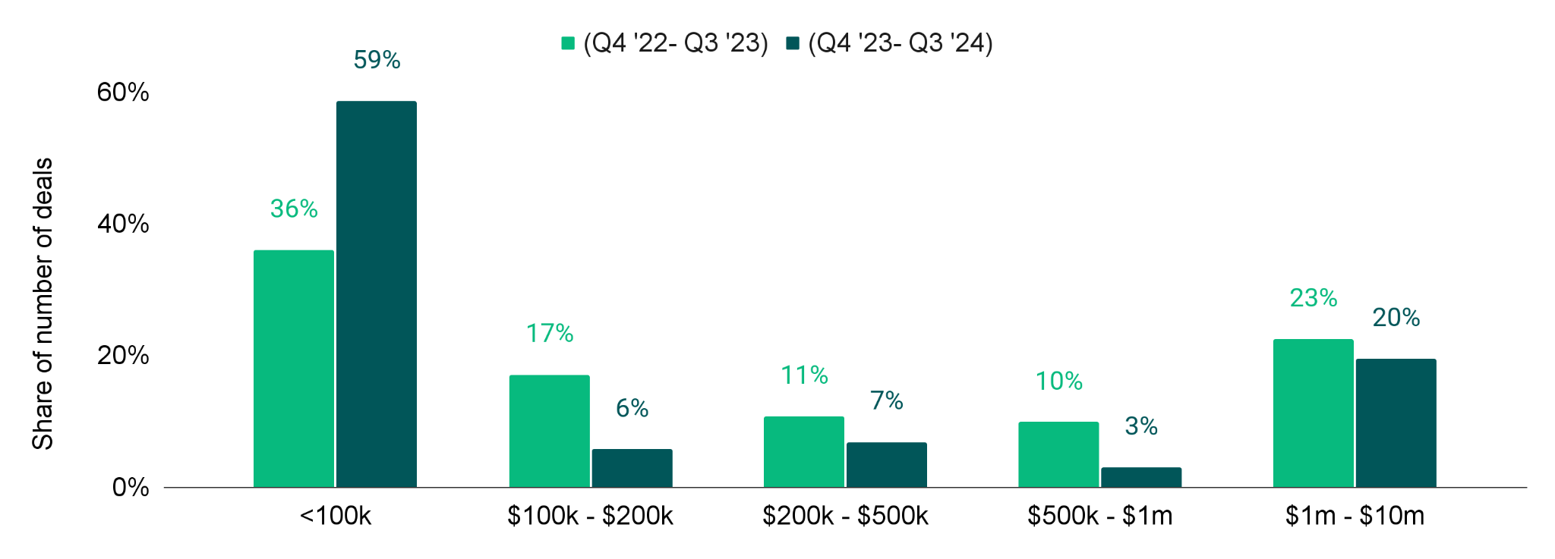
Trends from the last 12 months
Very early stage funding grew, later stage funding remained stable
State of AgTech Investment 2024
REPORT
The two most common publicly disclosed ticket size ranges for deals to AgTech startups were below $100 thousand and more than $1 million. Deals below $100 thousand accounted for 59% of deals in the last twelve months, up from just over a third of deals in the previous period. Deals above $1 million remained stable at around 20%.

Slide 14
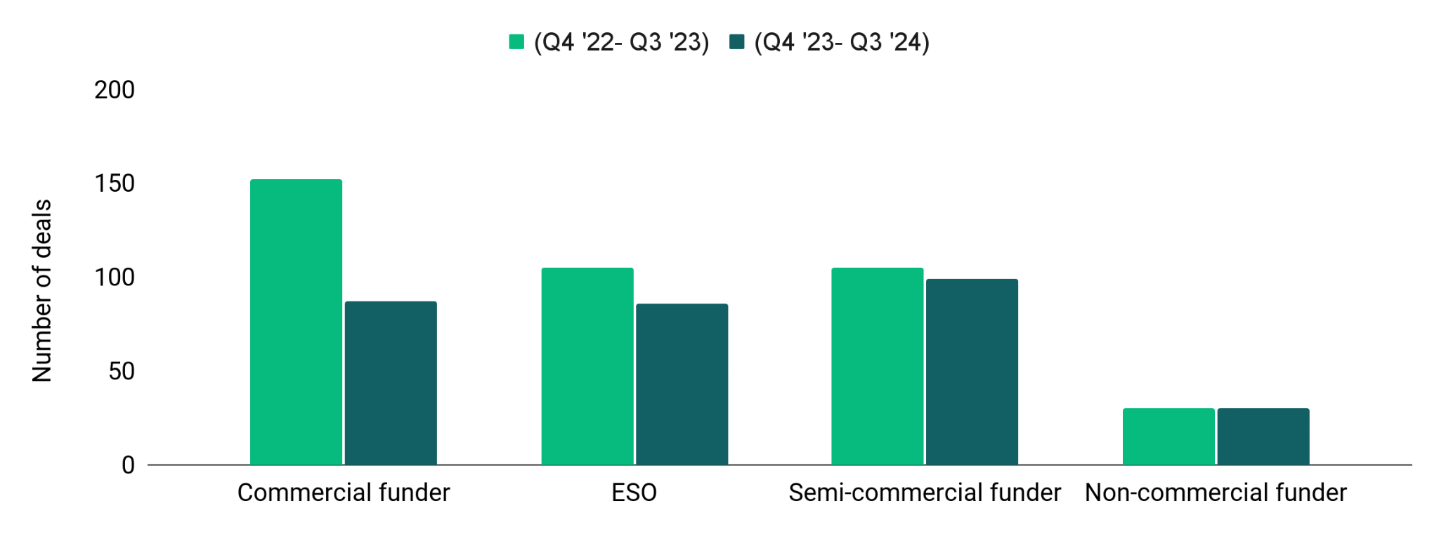
Trends from the last 12 months
Commercial deal flow continues to fall, semi-commercial and n
State of AgTech Investment 2024
REPORT
Deals from commercial funders and ESOs saw biggest drop, while deals for semi-commercial and non-commercial funders remained more resilient. They are also playing a bigger role later-stage deals with nearly 70% of AgTech deals over $1 million having at least one DFI, donor or impact investors as a funder.
-43%
-18%
-6%
0%

Slide 15
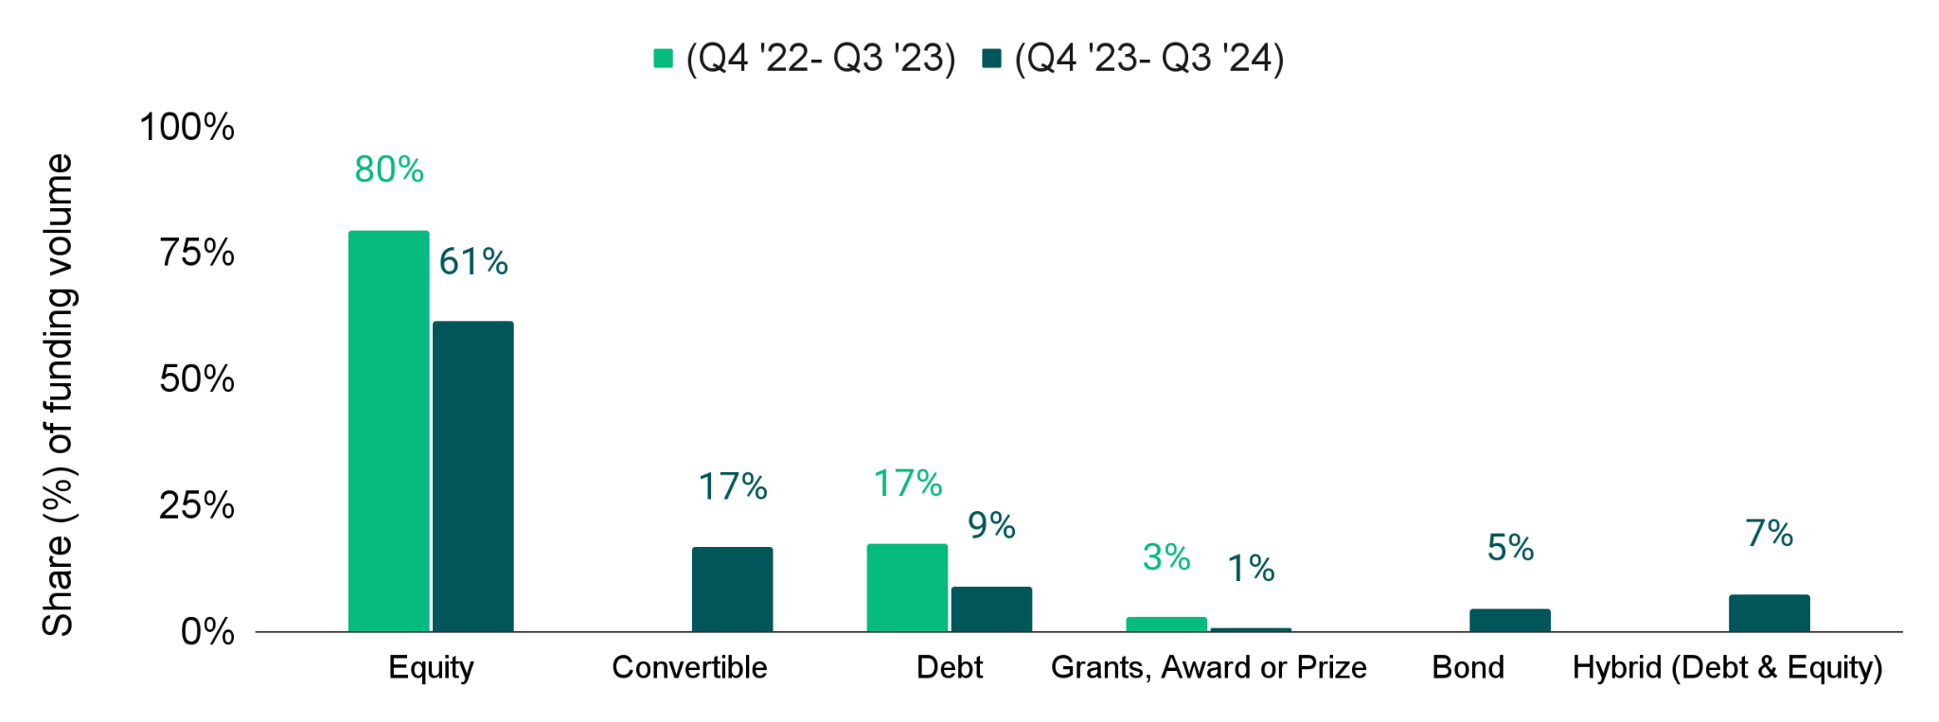
Trends from the last 12 months
Increasing diversification of funding instruments emerging
State of AgTech Investment 2024
REPORT
While the majority, 61%, of AgTech funding in the last twelve months has been equity-based, this is down from the previous period where equity accounted for 80% of the total volume of funding. The biggest growth came from non-traditional financing instruments such as bonds, convertibles and blended finance.

Slide 16
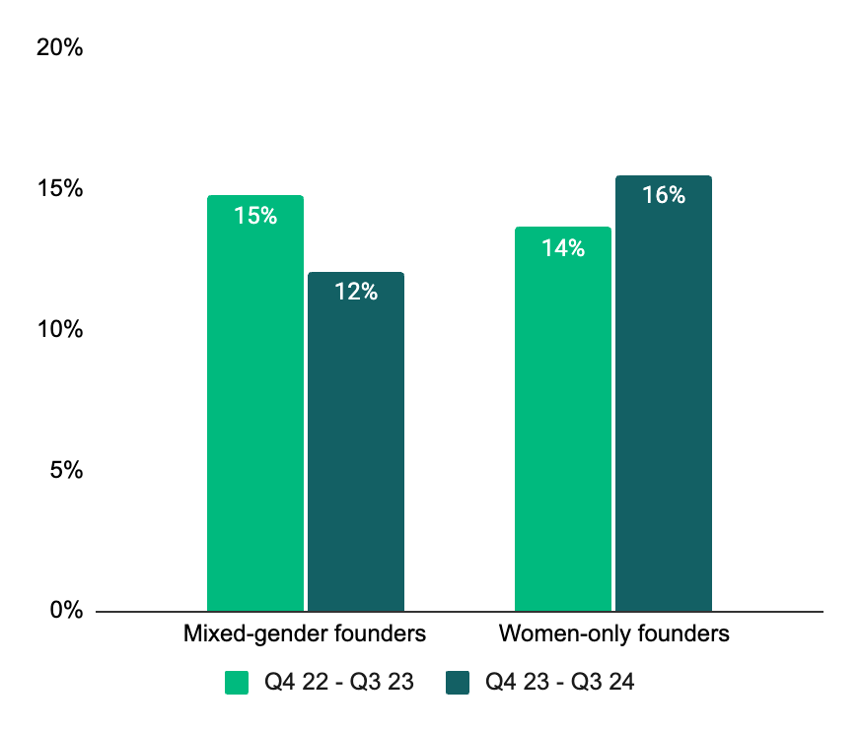
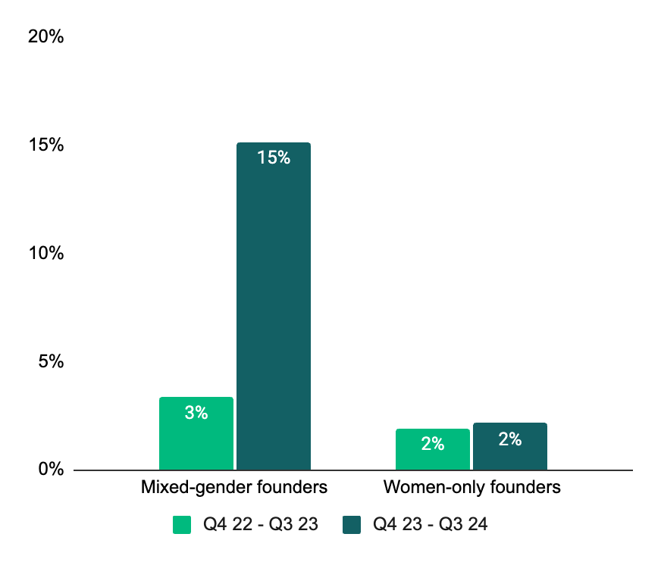
Trends from the last 12 months
Mixed gender funding up, but funding for all women-founded teams lagging.
State of AgTech Investment 2024
REPORT
AgTech startups founded by at least one woman have accounted for 17% of the total volume of funding, up from 7% in 2023. This is the opposite of what has happened in the wider startup ecosystem. However, all women-founded AgTechs share of volume is much lower at 2% in the last 12 months compared to 8% in the past decade.

Slide 17
Trends from the last 12 months
On-farm and post farm funding fell whereas retail and consumer grew.
State of AgTech Investment 2024
REPORT
Agtechs in the post farm value chain fell the most by more than 80%, whereas Agtechs in the on-farm funding fell marginally and still accounted for the majority of funding to Agtechs in Africa. he biggest growth was in the retail value where funding more than doubled.
-4%
+216%
-85%
28%

Slide 18
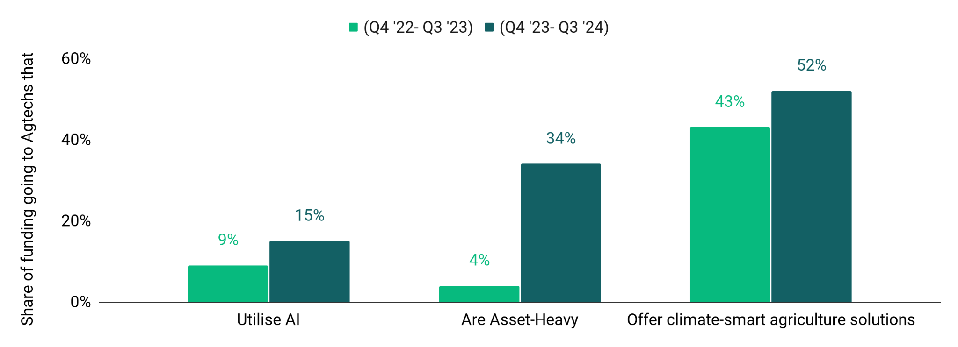
Trends from the last 12 months
Climate, “Hardware” and AI driving the next wave of AgTech funding
State of AgTech Investment 2024
REPORT
The product landscape is changing with asset-heavy AgTechs reaching 34% of funding over the last twelve months, AI-related deals growing from 9% to 15% and AgTechs offering climate-smart agriculture solutions have attracted more than 50% of total funding.

Slide 19
State of AgTech
Investment 2024
5 focus areas for the future of the Agtech ecosystem in Africa

Slide 20
The future of the Agtech ecosystem in Africa
5 areas of focus
State of AgTech Investment 2024
REPORT
#1
Focus on business models rather than products
#2
Reimagine the “ecosystem support stack”
Increase diversity and innovation in funding
#3
#4
Engage and align with corporates
Find commercial use cases for AI, inclusion and climate
#5

Slide 21
Thank you for your attention.

